Slide 1

We will be with you shortly.

Slide 2
Homepage - Surrey Safeguarding Children Partnership (surreyscp.org.uk)
SSCP-Final-Neglect-Strategy-2021-2023-1.pdf (surreyscp.org.uk)
Neglect-Strategy-on-a-page-April-2021.pdf (surreyscp.org.uk)
Family Resilience and Early Help - Surrey County Council (surreycc.gov.uk)
If you’re concerned about a child call 0300 470 9100 or email cspa@surreycc.gov.uk

Slide 3

Adolescent Neglect
Insp Dave Bentley

Slide 4
What is Adolescent Neglect?
How do you define adolescent?
How do you define the relevant elements of neglect?
Neglect is the persistent failure to meet a child’s basic and/or psychological needs, likely to result in the serious impairment of the child’s health or development. Once a child is born, neglect may involve a parent or carer failing to:
• provide adequate food, clothing and shelter (including exclusion from home or abandonment)
• protect a child from physical and emotional harm or danger
• ensure adequate supervision (including the use of inadequate care-givers)
• ensure access to appropriate medical care or treatment. It may also include neglect of, or unresponsiveness to, a child’s basic emotional needs.
(HM Government, 2006: 38)
Do we fully understand what young people need from their parents during adolescence, and what constitutes ‘adolescent neglect’?

Slide 5

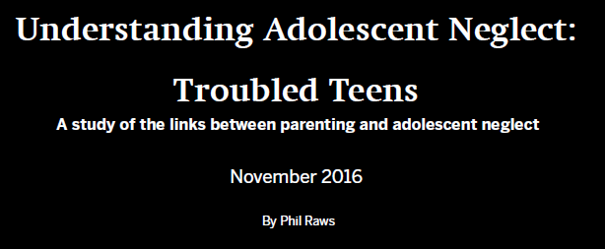
What does research tell us?
One in seven (15%) 14–15 year olds lived with adult caregivers who neglected them in one or more ways
What does that mean in these scenarios:
They may have shown little or no interest in them, not offered warmth or encouragement, made no effort to monitor or protect them or failed to promote their health.
Neglected young people reported low well-being and a higher propensity than their peers to behaving in ways which may jeopardise their health or their prospects.

Slide 6
How can we tackle Adolescent Neglect?
Pursue:
Does the legislation support this type of neglect in modern society?
Recognise the impact of this type of neglect on society
Use other legislation / enforcement methods where available
Prevention:
Recognising trauma at the earliest point
Setting the standard – what does society expect
Partnership delivery / support for families who are experiencing difficulty
Behaviour change in others

Slide 7
What are ACEs?
Domestic Violence
Substance Abuse
Mental Illness
Parental separation / divorce
Incarcerated Parent
Emotional Abuse
Physical Abuse
Sexual Abuse
Emotional Neglect
Physical Neglect
Is there a link between Adverse Childhood Experiences (ACEs) and adolescent neglect?
Are ACEs a precursor / indicator for adolescent neglect?

Slide 8
Young People who present with ACEs:
Be in a state of readiness to fight or Flight
Anxiety within most situations
Impulsive and hard to engage
Poor education and attainment
Hot tempered individual
Finds it difficult to build meaningful long lasting relationships/friendships
“There is nothing inevitable about criminality and poor outcomes in life”

Slide 9
How does adolescent neglect link to ACEs?
Adoption of health‐risk behaviours (eg drug/alcohol abuse, self‐harm, high‐risk sexual behaviour)
Increased risk of violence or re‐victimisation (including DA)
Mental health conditions (including suicidal & depressive disorders)
Higher levels of involvement in the criminal justice system
Early death

Slide 10
In Summary:
Do we need a partnership definition of adolescent neglect?
How can we use trauma to spot adolescent neglect before it happens?
Is our current legislation enough to tackle this type of neglect? If not, how can we change this?
How do we increase societal standards on parenting?
Do we have the appropriate support in place to offer help to those families who need this?
Working in partnership is key to support those who need our help but also pursue those who put our young people at risk both in the short and long term

Slide 11
Thank you for your time
Any Questions?

Slide 12
Surrey’s Approach to Safeguarding Adolescent’s
Investing Emotional Pennies – a Social workers view of contextual safeguarding
Video to follow

Slide 13
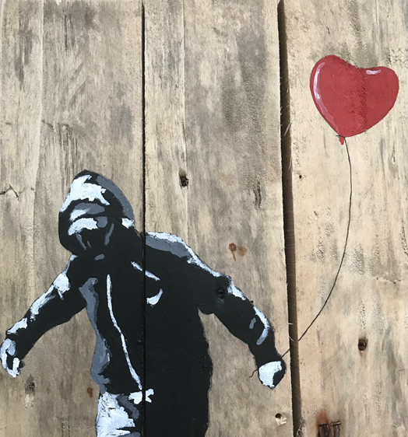
Surrey’s Approach to Safeguarding Adolescents
Safeguarding Adolescents
A Partnership Approach
Julie Speed – Child Exploitation & Hidden Crime Partnership Lead
Gabi Schaper – Safeguarding Adolescents Social Work Consultant
11th June 2021

Slide 14
Session covers:
Surrey’s Approach to Safeguarding Adolescents
Social worker case study
Surrey vision and guiding principles for all adolescents in Surrey
Describes the approach to child exploitation and other forms of extra-familial harm
Mythbusting – how to engage issue of neglect and adolescent vulnerability
Next steps

Slide 15
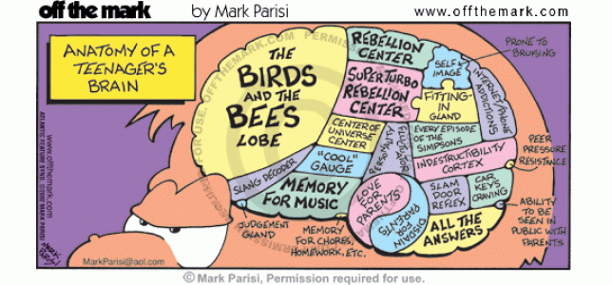
Surrey’s Approach to Safeguarding Adolescents
Our Every Day Guiding Principles
Would this be good enough for my child?
What kind of adult do we want the young person to be?
Are we managing risk for the child and the organisation?

Slide 16
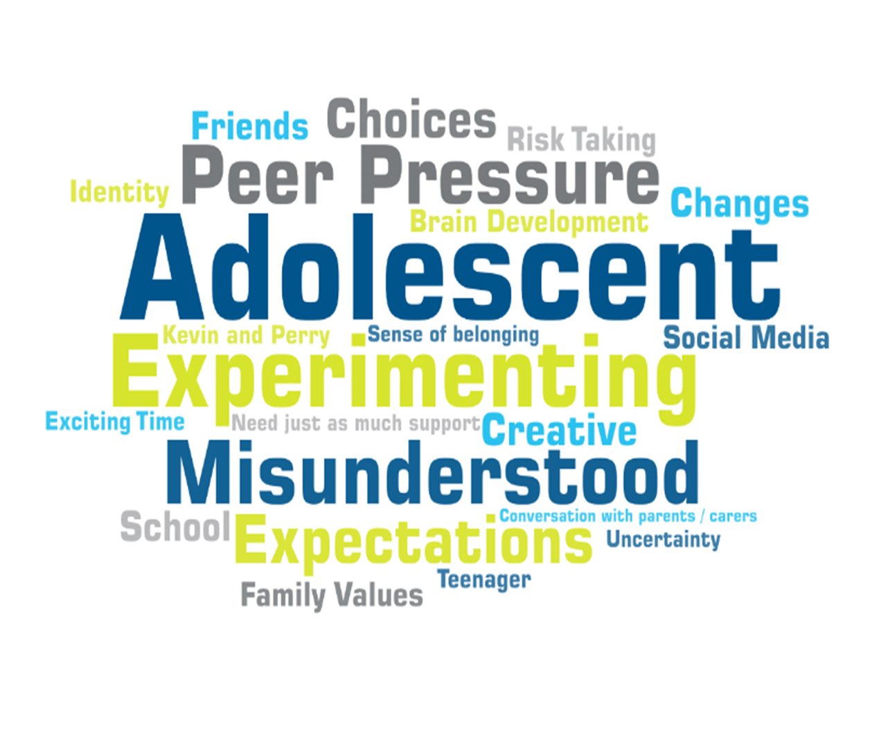
Surrey’s Approach to Safeguarding Adolescents
Surrey Approach to Safeguarding Adolescents
We will identify adolescents as children first
We will strive to understand the development needs of adolescents which are unique to each child
We will work together to understand the needs and risks for adolescents with SEND
We understand and recognise the influences in adolescent lives, including those outside the family context
We will maintain a focus on the risks that adolescents are exposed to in contexts outside the family, and respond with the right conversation and the right action at the right time
We will be considerate of the positive and negative impact of risks adolescents take in exploring their growing independence
Value the diverse range of experiences of the adolescents in Surrey and respond to the needs of adolescents of all genders, ethnicities, sexual identities and beliefs, and those children with disabilities

Slide 17
Extra-familial harm
Surrey’s Approach to Safeguarding Adolescent’s
Child Exploitation and Contextual Safeguarding
Sexual exploitation
Criminal exploitation
Serious youth violence
Bullying and social isolation
Radicalisation
Teenage relationship abuse

Slide 18
Extra-familial forms of harm are highly contextual
(Barter, 2009; Firmin, 2017; Firmin, Wroe and Lloyd, 2019; Hudeck, 2018)
Street-based victimisation and grooming
Criminal exploitation routes
Robbery
CSE in parks, shopping centres
Peer Group
Home
Child
Neighbourhood
School
Bullying
Corridor culture
Peer recruitment
Curriculum
Domestic abuse
Siblings
Neglect
Parental capacity
Peer association to intimate partner violence
Peer group sexual offending

Slide 19
Mythbusting understanding strengths-based practice
Surrey’s Approach to Safeguarding Adolescents
Child Exploitation and Contextual Safeguarding
Gabi Schaper - Safeguarding Adolescent Social Work Consultant and Systemic Family Therapist

Slide 20

Listening to young people
Surrey’s Approach to Safeguarding Adolescent’s
Child Exploitation and Contextual Safeguarding
Myth 1
“Gang culture is rife among young people and is taking over our schools”
Reality
Our User Voice & Participation Team (Jess Clarke and the team) surveyed lots of young people about youth violence and perceptions around safety.
This work tells us so much about what young people think around ‘gang culture’
Many young people dislike the term and do not want to be labelled in such way. In a survey carried out by the UVP team they found that a number of young people completing the serious youth violence questionnaires have not come across youth violence, gangs or dealing in their area. This is not say it doesn’t exist – but we need to listen.

Slide 21

Listening to young people
Surrey’s Approach to Safeguarding Adolescent’s
Child Exploitation and Contextual Safeguarding
Myth 2
“Once you are involved in child exploitation it is hard to escape”
Reality
As part of the Surrey User Voice & Participation engagement work – Crossroads – all of the young people spoken to talked about what worries them most. The standout issues were their mental health, their uncertain future (including jobs and money) and being safe from street crime.
Unsurprisingly, young people want a reason not to be ‘gang associated’; wanted reasons to do well in education and wanted to be asked about their future and asked about how to get help and support.

Slide 22

Myth 3 Disrupting extra-familial harm and child exploitation is a job for the police?
Surrey’s Approach to Safeguarding Adolescent’s
Child Exploitation and Contextual Safeguarding
Reality
This is true that the police will undertake disruption activity to prevent further harm to young people such as issuing warning notices and risk orders to offenders. However, there is so much more that all partners can do to support this. Examples, talking to your local JAGs or CHaRMM chairs or set up your own local mapping meeting.
Conclusion: in order to drive up our safeguarding around locations we need to develop relationships beyond the usual police, social care and education.

Slide 23

There is a lack of early intervention to support schools when grooming or other harmful behaviours arise?
Myth 4
Surrey’s Approach to Safeguarding Adolescent’s
Child Exploitation and Contextual Safeguarding
Reality
Together with schools and other partners, Surrey Police have piloted an early help programme to identify children and young people needing support at the first sign there is an issue. Part of the EH programme looks at trauma – informed backgrounds and ACE’s to see the ‘needs of the children’ as opposed to reacting to the behaviours. Supported by local schools the Youth Intervention Officers will support a full Surrey roll out (currently in Woking and Surrey Heath)
Conclusion: there is lots going on and clearly more to do. Redefine early intervention and be open to partnership possibilities.

Slide 24
Surrey’s Approach to Safeguarding Adolescents
Working Together with Surrey Police, Education Settings, NHS, Voluntary and Faith Sector, Local district & boroughs and Families.
Child exploitation - Healthy Surrey – for Public and Professionals – toolkits and information
Surrey Safeguarding Children Partnership (surreyscp.org.uk) – how to refer, practice guidance and Child Exploitation Assessment Tool.
Risky behaviour in teenagers | Surrey's Family Help Hub (surreysfamilyhelphub.org.uk)
Homepage (csnetwork.org.uk) Join free Contextual Safeguarding network for Practitioners

Slide 25
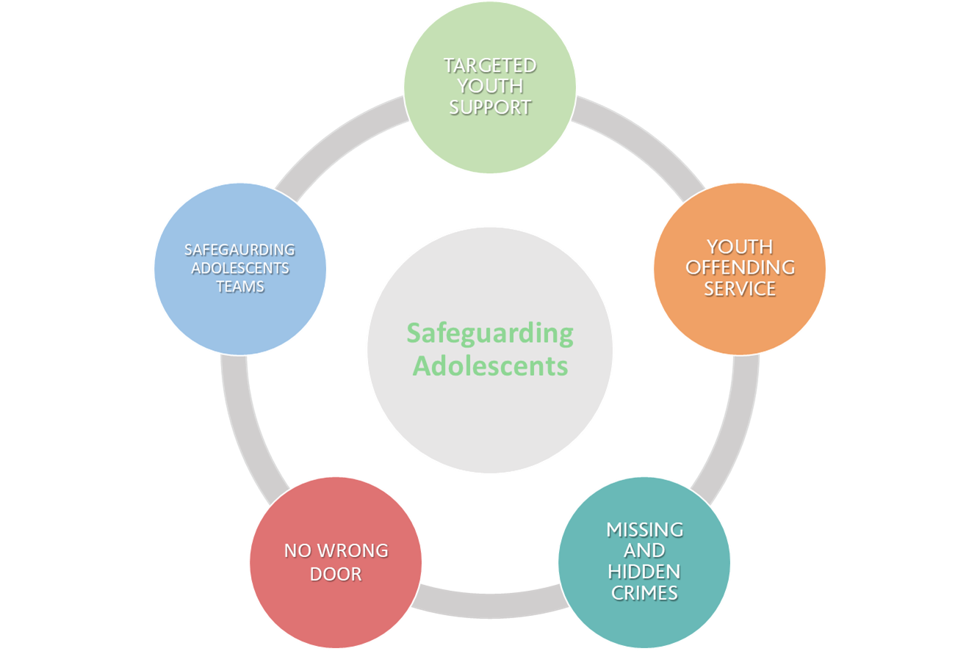
Safeguarding Adolescents: An Integrated Model

Slide 26
Margaret Gallagher
Head of Local Campaigns
NSPCC – Adolescent neglect

Slide 27
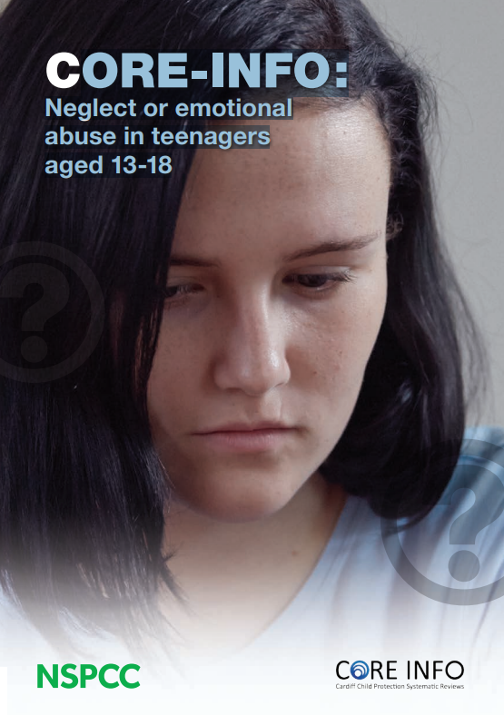
Teenagers and neglect
How to identify and help teenagers who may have been emotionally abused or neglected
Neglect and emotional abuse are often not recognised in teenagers. Their behaviours may be interpreted by others as a lifestyle choice or ‘acting out’.
This leaflet summaries the research about teenagers’ experience of neglect and emotional abuse. It highlights findings about victimisation; perpetrators of violence or delinquency; future expectations; emotional wellbeing and risky behaviours.
It finds that a better understanding of teenage neglect and emotional abuse may enable teenagers to access appropriate and timely help.
Ref: Cardiff University, Department of Child Health and NSPCC (2014) Core-Info: neglect or emotional abuse in teenagers aged 13-18. London: NSPCC
Notes:
Core info series
The Core info leaflet series is based on a collaborative project by the NSPCC, Cardiff University and the Royal College of Paediatrics and Child Health (RCPCH).
The RCPCH are engaged in a rolling programme of systematic reviews of published research literature, originally developed by Cardiff University, on aspects of physical child abuse and neglect.
The full systematic review findings including research questions and methodologies as well as information about all of the reviews and annual updates being under taken can be found in the Child Protection Evidence resource on the RCPCH website.

Slide 28

NSPCC
NSPCC CORE-Info leaflet summarises the scientific literature that describes what teenagers aged 13-18 years who are experiencing neglect or emotional abuse tell us about themselves.
It focuses on how these teenagers view themselves and their experiences. The literature review did not account for findings observed by others as only self-reported features were taken into account.
For all of the teenagers in the studies that were reviewed, neglect and/or emotional abuse were confirmed by the statutory agencies; many were in out-of-home care at the time of the studies. For many of the teenagers, although they were being neglected or emotionally abused at the time of the studies, this may have also been going on throughout their younger years. The impact of this earlier childhood neglect and abuse is outside the scope of the summary.
Notes:
Victimisation
In one study neglected girls reported being the victims of physical assault, but the neglected boys did not. Another study reported that neglected teenagers may be the victims of dating violence.
Emotionally abused boys and girls have also reported being the victims of dating violence.
Perpetrators of violence or delinquency
One study has shown that physically neglected boys are no more likely to be the perpetrators of dating violence than other teenagers.
However, one study showed that emotionally abused boys may perpetrate dating violence.
One study reported that older neglected boys may exhibit delinquency
Future expectations
Emotionally neglected teenagers did not express confidence in their future. They have high levels of daily stress, including anxieties relating to school, work, health, and finance.
Neglected boys tend to engage more in school, while neglected girls tend to engage less in school.
Emotional wellbeing
Compared with similar age groups in the community who had not been maltreated, neglected teenagers were more likely to experience depression, particularly if they were younger than 15 years old. However, they were not more likely to express suicidal ideation.
Emotionally abused and neglected teenagers did express more internalising features, such as being withdrawn, anxious, depressed, angry, experiencing post-traumatic stress symptoms, or sexual concerns than teenagers who hadn’t been maltreated. And they were three times more likely to express suicidal ideation than children at risk of other types of abuse or neglect.
The research found no association between teenagers who were neglected or emotionally abused and low self-esteem
Risky behaviours
Adolescence is a time of increasing independence and exploration, which can include trying out different lifestyles and engaging in some risk-taking as part of normal development. However, this can lead to teenagers’ actions being written off as ‘typical teenage behaviour’ instead of a sign of emotional abuse or neglect.
Below are some of the key findings from the review relating to risky behaviour and emotionally abused and neglected teenagers.
Substance misuse: Some neglected teenagers may exhibit alcohol-related problems in both early and late teens. Although it is clear that neglected teenagers may be highly likely to engage in substance misuse, particularly those aged 14-16 years, many of the studies did not compare them to other teenagers in the same community. Therefore, it is difficult to determine how much more likely they are to engage in substance misuse. The studies did not find any association between teenagers who had been emotionally abused and their reported alcohol or substance misuse.
Sexual behaviour: One small study showed an increased risk of teenage pregnancy amongst neglected teenagers. However, there is little research relating to risky sexual behaviour and the links with neglect or emotional abuse.

Slide 29
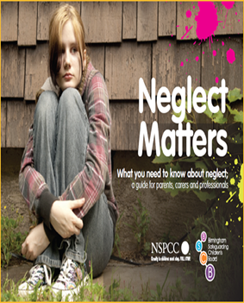
Recommendations:
A better understanding of teenage neglect and emotional abuse may enable teenagers to access appropriate and timely help.
• All practitioners coming into contact with teenagers who exhibit the behaviours and issues outlined must actively consider neglect or emotional maltreatment, rather than simply addressing the problems they present, such as alcohol use.
• Remember, teenagers who have experienced neglect or emotional abuse may be particularly vulnerable to other forms of victimisation; therefore appropriate action should be taken.
• A sensitive exploration of teenagers’ experiences may help professionals understand their situation, and allow the teenagers to access appropriate support themselves.
• Hospital emergency departments and mental health providers need to be particularly aware that teenagers, especially the victims of violence, may be experiencing neglect or emotional maltreatment.

Slide 30

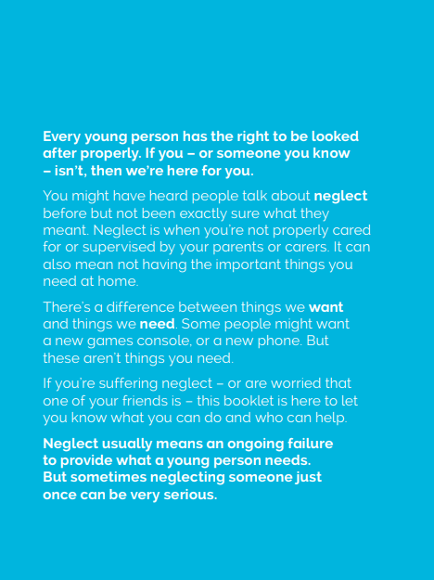

Teenage Neglect – Feeling Invisible
Notes:
information on reaching adolescents, this is because teenagers are often viewed as being more resilient than younger children, but research shows they still need dedicated care to meet their physical and emotional needs, support their education, and keep them safe.
A guide for young people, called Feeling Invisible, will also be distributed, and adults in Bedfordshire will be able to get advice about how to recognise neglect in GP surgeries, community spaces such as sports centres and libraries, and online.
The NSPCC’s campaigns manager for Bedfordshire, Emma Motherwell, said: “It is so important that we understand the true nature and scale of child neglect in Bedfordshire, so we can collectively tackle the fundamental causes and reach out to young people who need our help.
“Neglect can have a huge impact on a young person’s physical and mental health, and can even be an indicator of other forms of abuse. Neglect is the most common reason for taking child protection action.

Slide 31
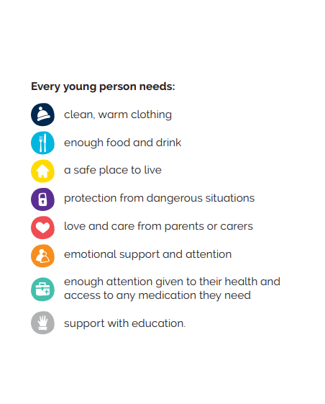
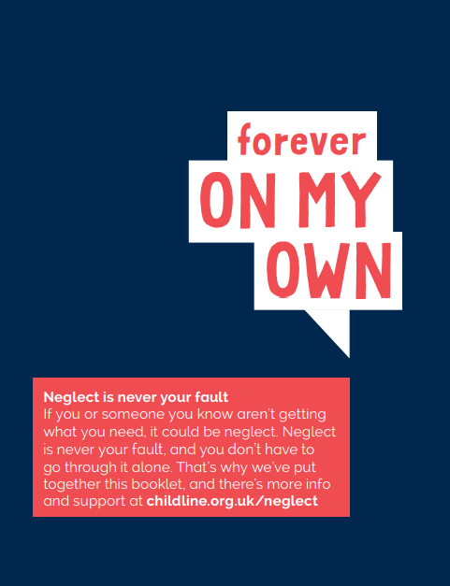
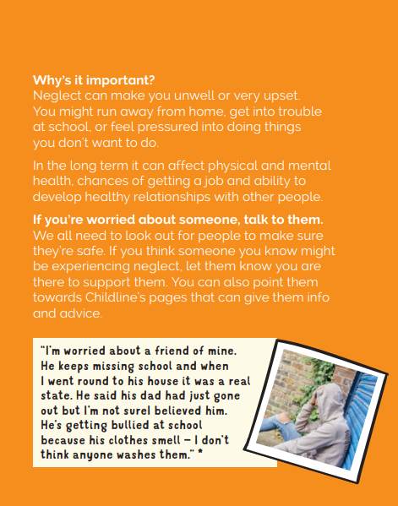
.

Slide 32
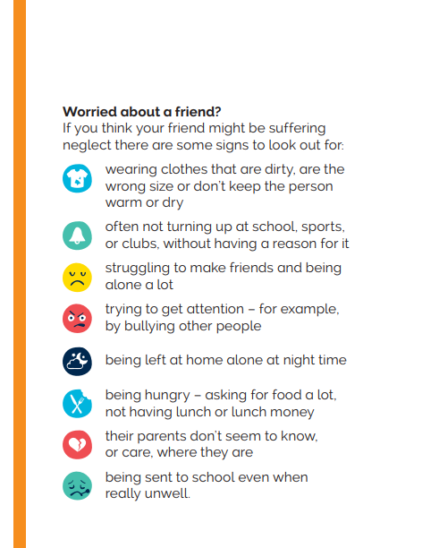

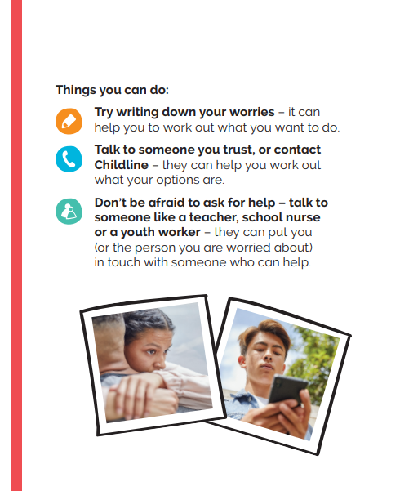

Slide 33

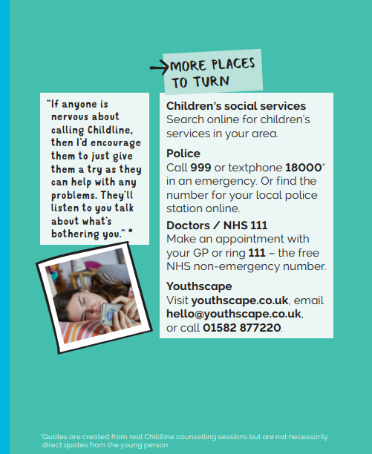
This guide has been produced by NSPCC
in partnership with
Bedfordshire Luton
Safeguarding Children Boards for a previous neglect campaign – downloadable from the link below
https://www.centralbedfordshirelscb.org.uk/lscb-website/news/bedfordshire-neglect-matters-campaign

Slide 34
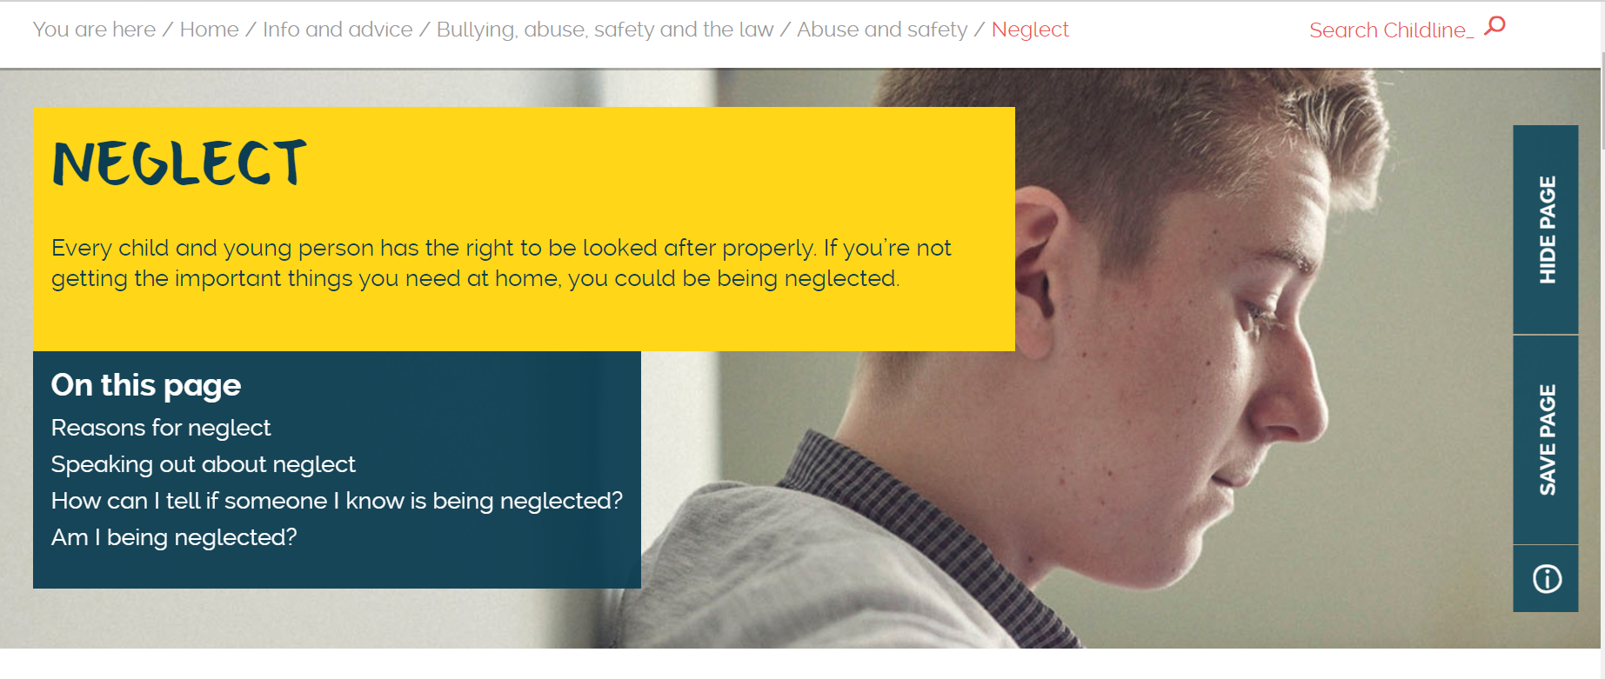
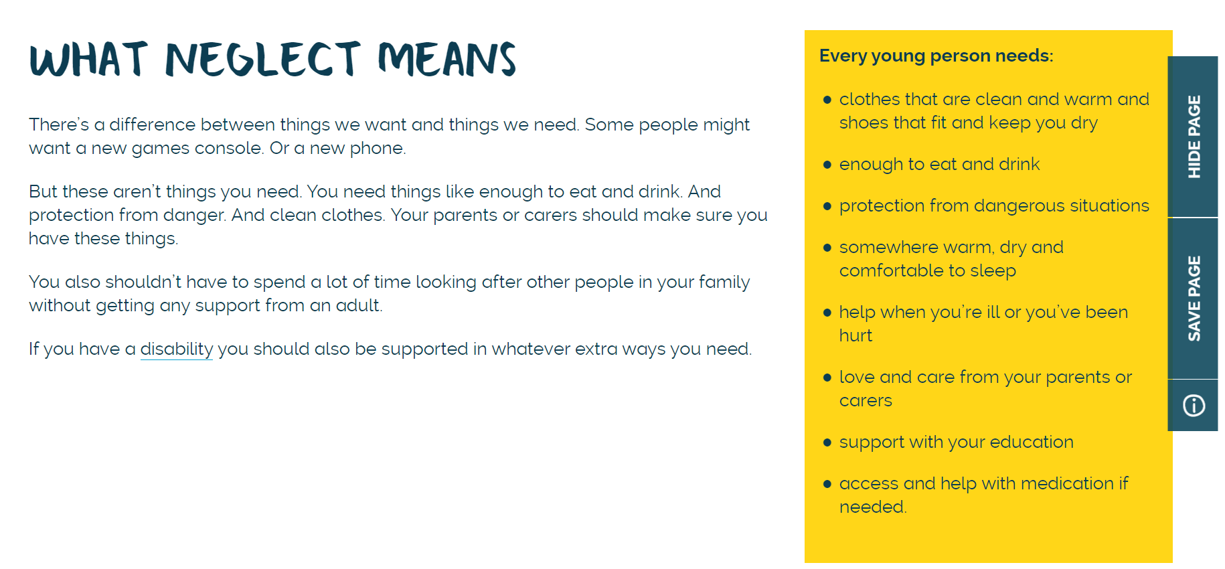
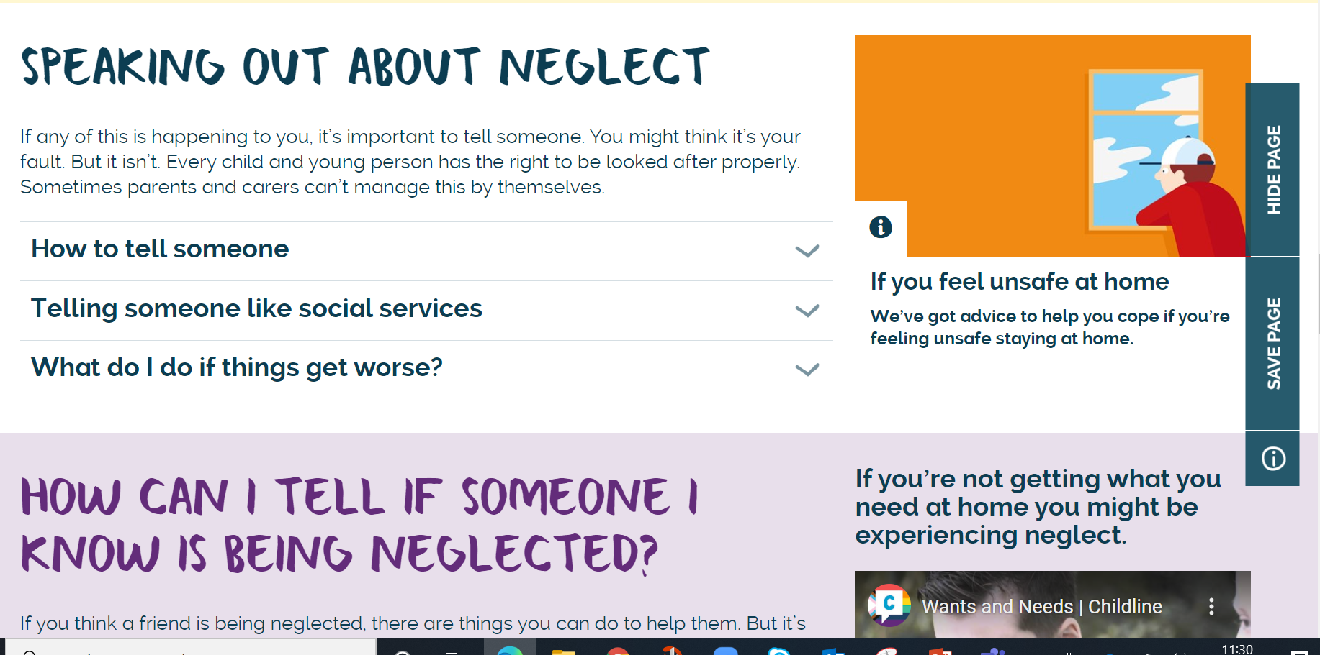
Childline.org.uk
Website 12yrs+

Slide 35
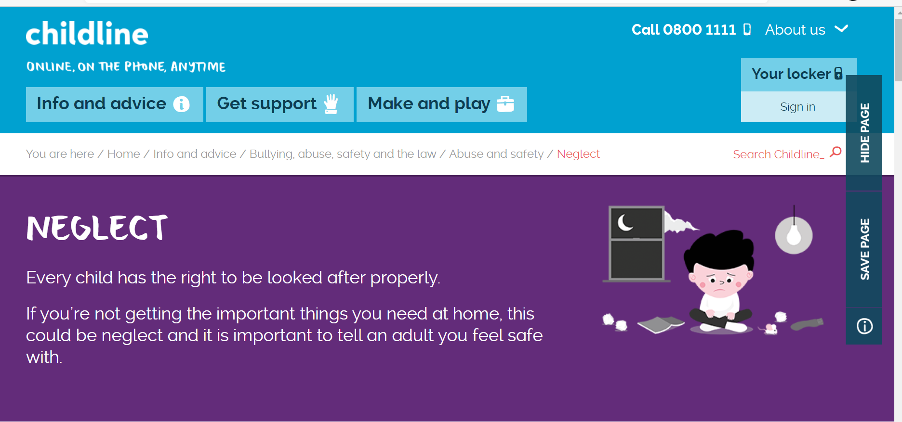
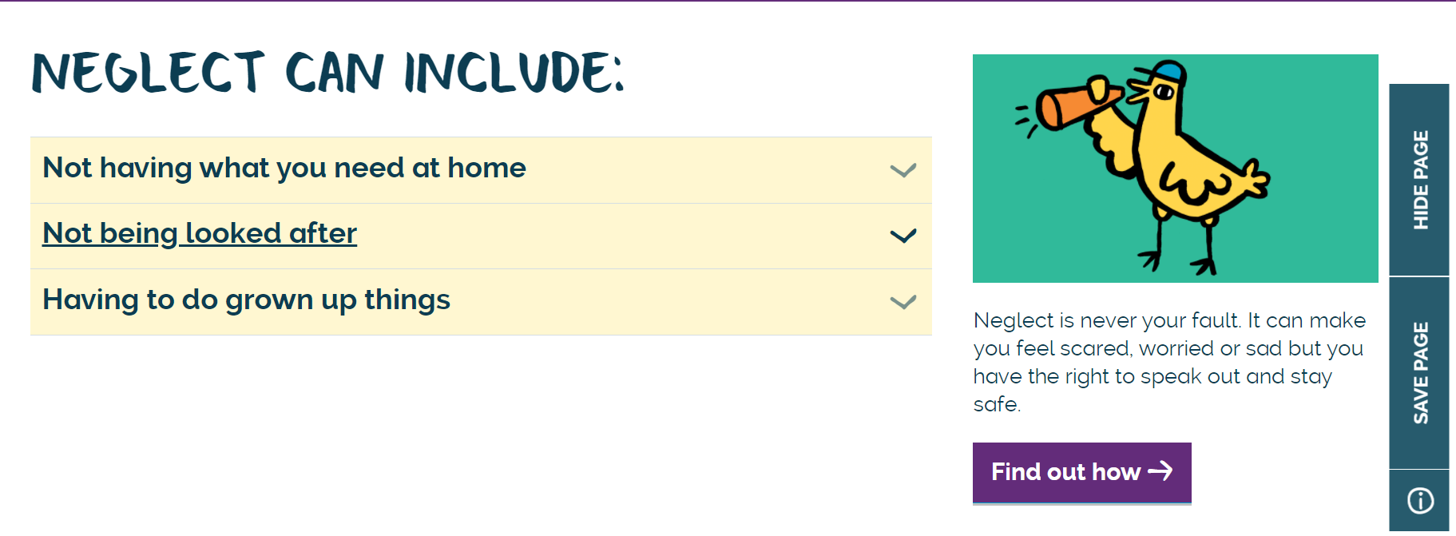
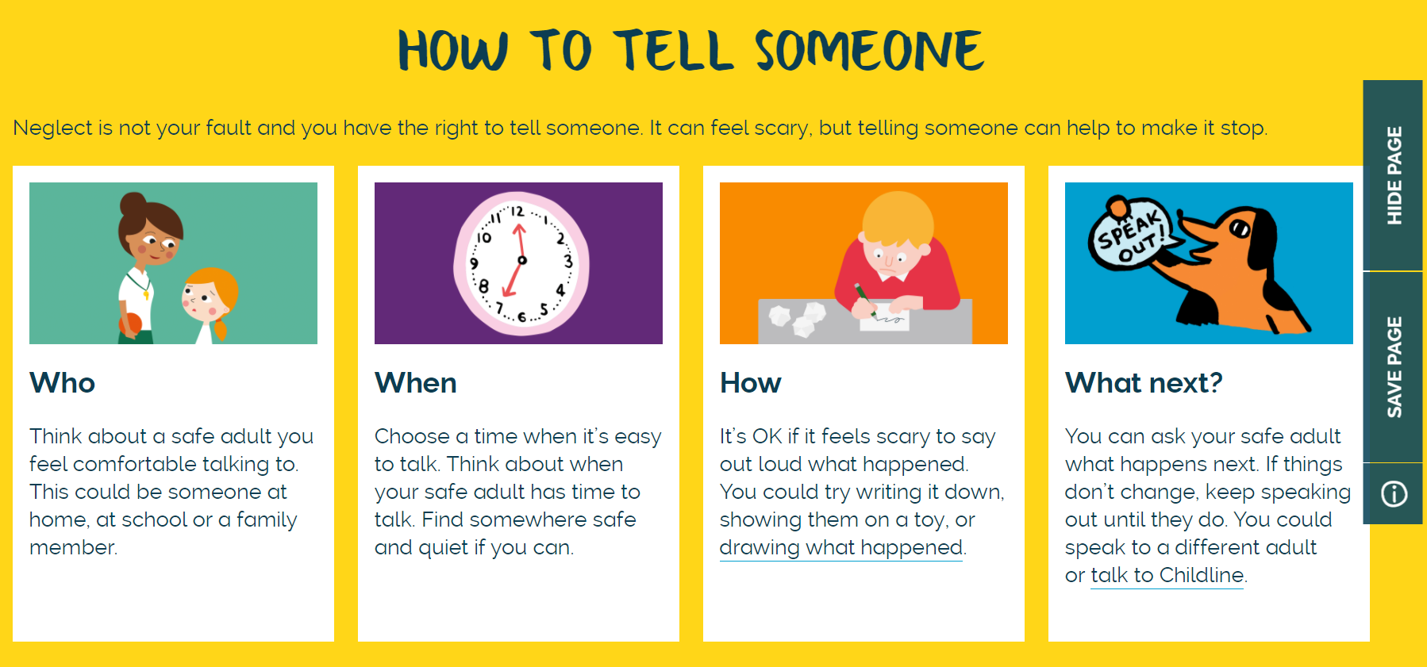
Childline.org.uk/kids
Website for under 12s

Slide 36
NSPCC - getting support
While early recognition and intervention are vital, it is never too late to help a child or teenager. If concerns about possible neglect or emotional abuse arise it is important you take action as soon as possible regardless of the age of the teenager.
If you have a concern you can call the police, social services or the NSPCC (0808 800 5000).
And remember that children can contact ChildLine (0800 1111; childline.org.uk)

Slide 37
Margaret.Gallagher@nspcc.org.uk

Slide 38

GCP2 Project Manager Alex Dave
Graded-Care-Profile2-FAQs.pdf (surreyscp.org.uk)
Neglect Risk Assessment Tools – General Guidance
Graded Care Profile 2: measuring care, helping families - YouTube

Slide 39

GCP2 Project Manager Alex Dave

Slide 40
Personal story from one of our Surrey young people

Slide 41

Family Information and Local Offer
Children who make good overall progress in most areas of development and receive appropriate universal services such as health care and education.
They also use leisure and play facilities, housing and the voluntary sector.
Family Information Service (information on resources) www.surreycc.gov.uk/people-and-community/family-information-service/

Slide 42
The SCSA partnership learning and development offer aims to enhance working together to safeguard children and improve outcomes for children and families in Surrey. Our workshops and learning events give the opportunity for practitioners to:
Share knowledge and explore understanding of their differing roles
Understand how safeguarding operates in Surrey by sharing good practice, resources and processes; this includes Effective Family Resilience and Family Safeguarding model
Learn from each other’s experience and practice in terms of safeguarding and delivering positive outcomes for children
Develop best practice and learning from local reviews and audits, domestic homicide reviews, the Child Death Overview Panel (CDOP) and national learning

Slide 43
Core Offer
Learn together to ensure clear pathways for support, effective multi-agency working and early help provision as well as clear understanding and consistent application of thresholds across the partnership
Working together to safeguard children (online offer, face to face and Train the Trainer)
Effective Family Resilience
Helping Families Early
Foundation Modules 1 and 2
DSL new to role and refresher (Education Safeguarding Team)
Managing Allegations against staff and volunteers (Education Safeguarding Team) – includes sessions for non-education practitioners
Healthy outcomes for children who are looked after

Slide 44
Olive booking link; https://surreycoun.plateau.com/learning/user/portal.do?siteID=SCA&landingPage=login
Neglect training offers to ensure that practitioners are supported with the awareness, skills and tools to effectively intervene where neglect is a factor;
Introduction to Neglect
GCP2 programme (includes Train the Trainer)
Train the Trainer (Learning from Practice)
Included in all learning activities of the core offer
Introduction to Neglect Workshops
19 July 2021
06 October 2021
02 February 2022
27 April 2022

