Slide 1

We will be with you shortly.

Slide 2
Homepage - Surrey Safeguarding Children Partnership (surreyscp.org.uk)
SSCP-Final-Neglect-Strategy-2021-2023-1.pdf (surreyscp.org.uk)
Neglect-Strategy-on-a-page-April-2021.pdf (surreyscp.org.uk)
Family Resilience and Early Help - Surrey County Council (surreycc.gov.uk)
If you’re concerned about a child call 0300 470 9100 or email cspa@surreycc.gov.uk

Slide 3


Slide 4
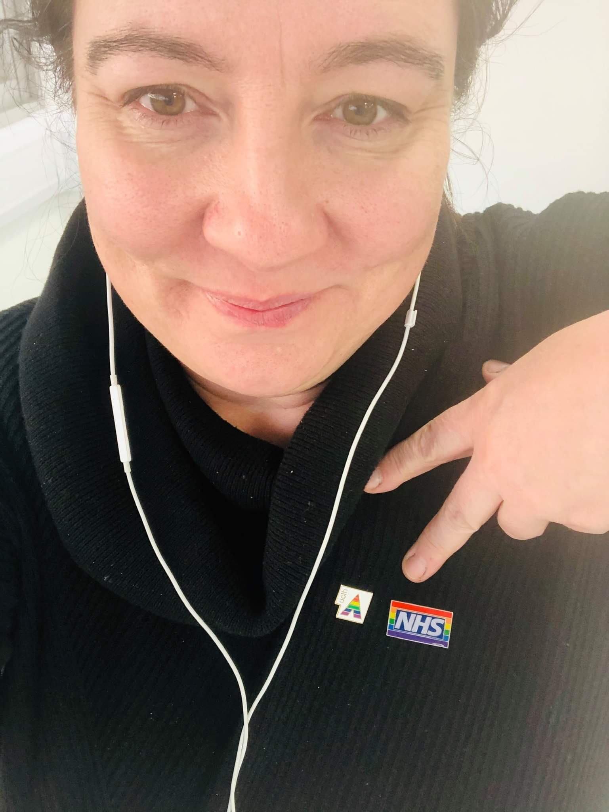
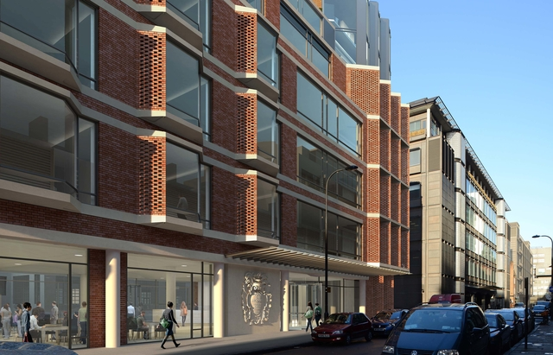
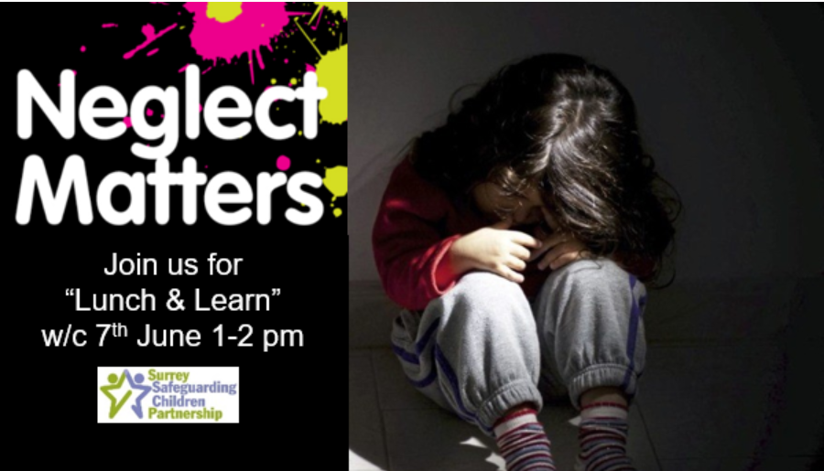
‘Dental / Oral Neglect’
Adèle Johnson, Consultant in Paediatric Dentistry &
Safeguarding Children Lead, RNTNE & EDH, UCLH
Lunch & Learn
7th June, 2021
1-2pm

Slide 5

Objectives
Background & role
Why teeth matter & common problems
Safeguarding & dentistry
Dental neglect as part of overall neglect abuse
Professional duty to be curious (irrespective of agency)
What can we do to make a positive change? 1 action

Slide 6

Background – Paediatric Dentistry
Birth - 18 years
Reasons > 1 often
Referrals - GDPs, community dentists & other health care professionals
Treatment in the chair, with sedation, or general anaesthetic (GA) - healthy or medically compromised / special needs
……whilst safeguarding all patients

Slide 7
The landscape…
Oral health ‘A standard of health of the oral & related tissues which enables an individual to eat, speak & socialise without active disease or embarrassment and which contributes to general wellbeing’ (Department of Health, 1994)
Baby
Transition
Toddler
Child
Adulthood
*Adolescent
Relative of adult patient / dependants
Patient

Slide 8
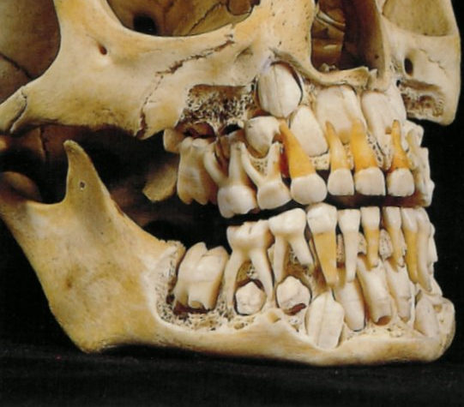
Do teeth matter…..?
Babies / tooth fairy / braces
Milk / baby / primary teeth
Function
Aesthetics
Health
Long-term effects on child
(underlying adult teeth)

Slide 9

Common problems with teeth
Decay / dental caries
Dental trauma
Dental anomalies – tooth number / size / shape / form / structure
Orthodontic-related – impacted teeth, occlusal problems
Oral mucosal problems – ulcers, lumps & bumps
Periodontal
Pathology

Slide 10
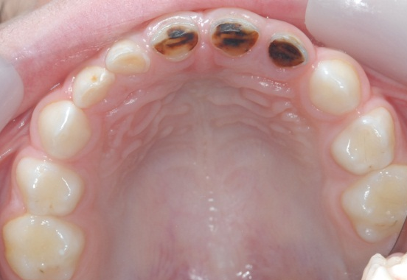
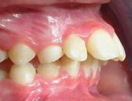
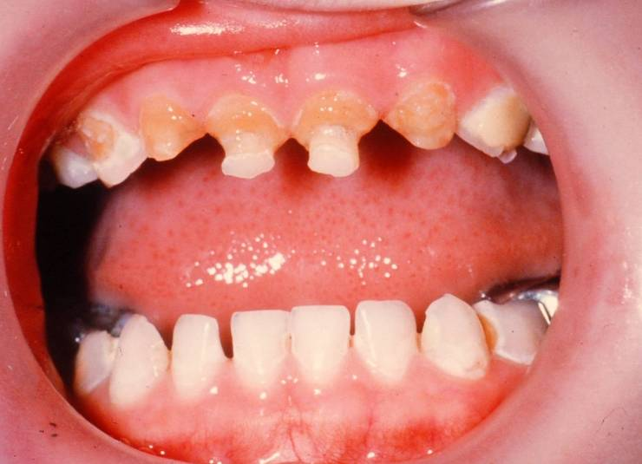
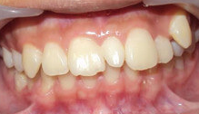

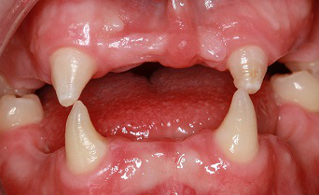
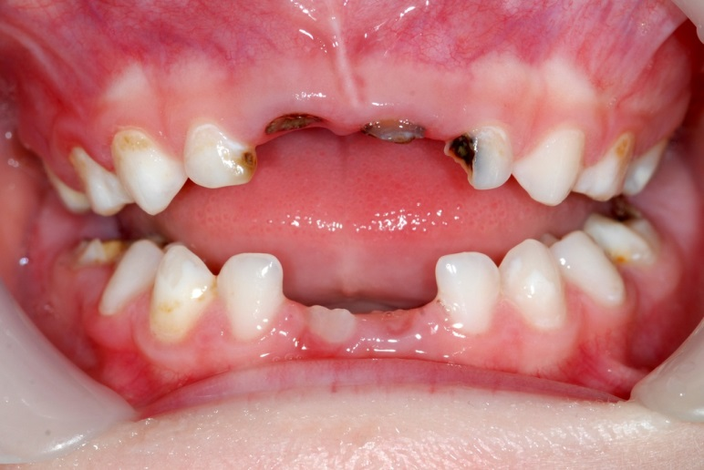
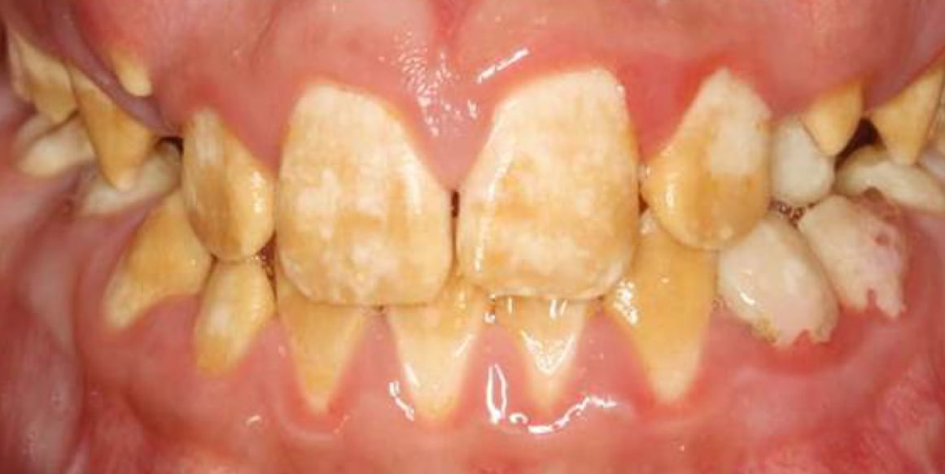
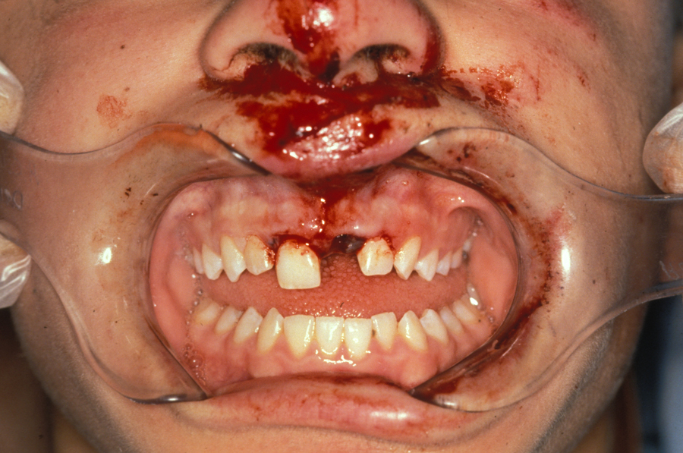

Slide 11
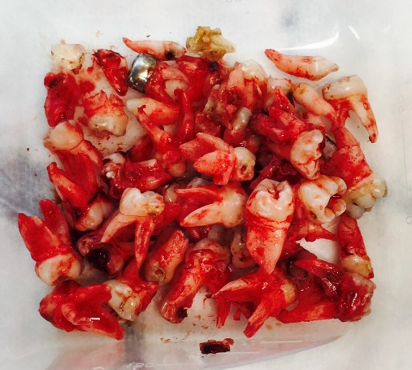
Dental Caries
Is largely preventable, health inequality
Multifactorial aetiology – bacteria / tooth / sugar / time = caries (Management strategies - monitor / fill / extract)
Manpower & Finance HUGE
Extraction of carious teeth is the most common reason for the hospital admission of children in England > 43,000
5–9 age group rising (26,000 in England in 2018)
Public Health England, National Dental Epidemiology
Programme for England: oral health survey of 5-year-olds 2019..

Slide 12
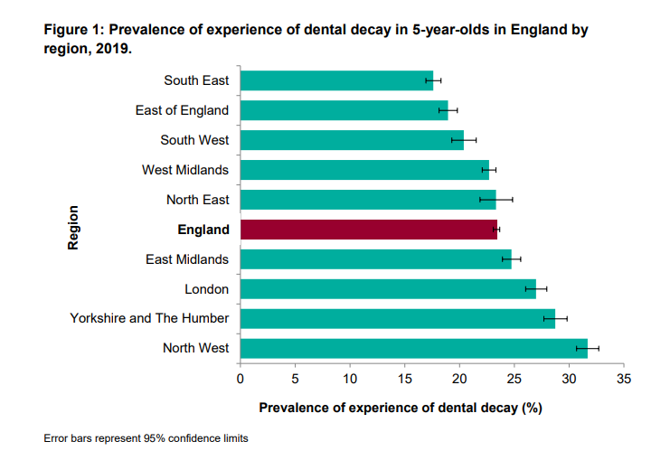

Slide 13
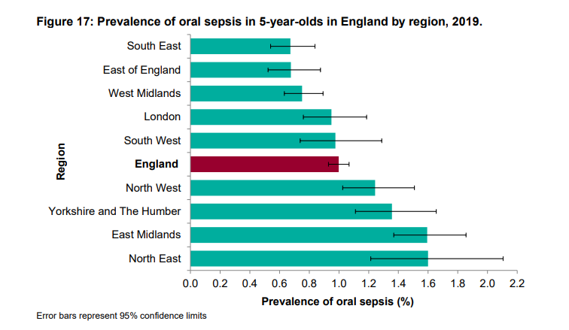

Slide 14
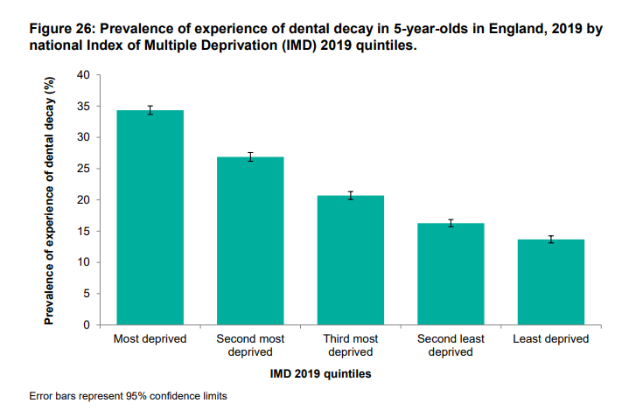

Slide 15
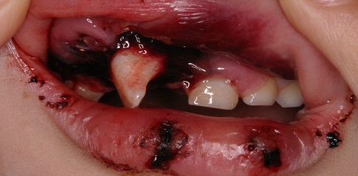
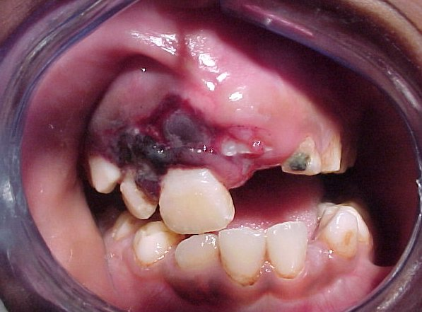
Dental Trauma
Male > Female, 1:2 children
Accident prone ages
LONG-TERM follow-up needed
Fracture upper adult central incisor most common - remember SOFT tissues - tongue, palate, head & neck
NAI*

Slide 16
Optimal oral health - 4 essential components
Fluoride - a regular source, usually supplied by twice daily use of fluoride toothpaste
Diet - limited frequency of sugary snacks & drinks (labelling, selling, advertising) – impact on health burden – obesity, diabetes
Oral hygiene - facilities, supervision & assistance
Dental visits - to benefit from preventive care & treatment when needed

Slide 17

‘Safeguarding is everyone’s responsibility’
2013 - Cardiff systematic review of the dental neglect literature
2019 – BDA, WNB Toolkit
&
PHE, toolkit for dental teams in practice
2009 - BSPD policy document on dental neglect
&
NICE ‘When to suspect child maltreatment’ includes dental attendance
Protect from maltreatment & Prevent impairment of health
‘Child protection
&
the dental team’
2006
HOLISTIC,
contextual

Slide 18
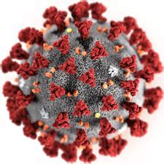
Contributors with similar challenges
Complex families
Health
& CAMHS
Education
Social care
Police
Effective partnerships, joined-up approach
Time
Thresholds (critical vs lived experiences)
Accumulation impact
Agency perspective differences
Knowledge
Opportunity
Common focus..

Slide 19
Health
Basic Care
Education
Ensure Safety
Emotional Behavioural Development
Emotional Warmth
Identity
PARENTING CAPACITY
Stimulation
CHILD’S DEVELOPMENTAL NEED
Family & Social Relationships
CHILD / YP
Safeguarding & promoting welfare
Guidance & Boundaries
Social Presentation
Stability
Selfcare Skills
FAMILY & ENVIRONMENTAL FACTORS
Community Resources
Family’s Social Integration
Family History & Functioning
Housing
Income
Housing
Employment
Wider Family

Slide 20
Role of the Dental Team
?
Assessing / recognise / > 1 presentation
Layer - something or nothing unless an emergency
Providing help or services as part of an agreed plan
Treating (emergency / longer term)
Sharing information (SC), consent / referrals S17 > S47
Appropriate environment
Presentation:
Oral/Dental Aspects of Abuse & Neglect - Mouth & Maltreatment - safeguarding issues in dental health (2018, Harris,J)

Slide 21
Safeguarding Themes & Case Examples
Parental Responsibility
Consent to treatment
History - *trauma
WNBs
Prevention
Language barriers
Telephone / video consults
Cramped conditions, help
15, trans male, Mother left, out of school, jaw lesion
Slash marks wrist 15 female having sedation

Slide 22

Neglect & Dental Neglect
‘..the ongoing failure to meet a child's basic needs & the most common form of child abuse’
(NSPCC)
Physical neglect
Educational neglect
Emotional neglect
Medical neglect
The British Society of Paediatric Dentistry (BSPD) describes dental neglect as:
'the persistent failure to meet a child's basic oral health needs,
likely to result in the serious impairment of a child's oral
or
general health or development'
British Medical & Dental Associations

Slide 23
Outcome of untreated decay
Severe acute infection which can cause life-threatening systemic illness
Sleep disturbance
Pain / altered behaviour
Play & socialisation
School absence (work) / concentration
Difficulty eating, food preference
Needing repeated antibiotics
Bullying
Damage to adult teeth
Repeated exposure to the morbidity associated with general anaesthesia
Weight loss

Slide 24
COVID-19 and the impact on child dental services in the UK
‘..little consideration has been given to oral health, an aspect of child health which is commonly overlooked but deserves to be prioritised due to its impact on general health’
CDO - 25 March 2020 that all routine, non-urgent dental care should be stopped & deferred
June ‘20, capacity to see patients in NHS general dental practice ↓
Cancellation of elective tooth extraction op’s for dental caries
Instead of delegating the responsibility to dentists alone, all healthcare workers (paediatricians & general practitioners, nurses, midwives & health visitors), parents, schools & other institutions should work collaboratively to tackle child oral health
https://bmjpaedsopen.bmj.com/content/5/1/e000853
Oral health highlighted in the Royal College of Paediatrics & Child Health’s 2020 Child Health Report

Slide 25
Dental neglect
Irregular attendance & repeatedly failed appointments
‘Was not brought’ rather than ‘Did not attend’*
Repeated cancellations ‘Disguised non-compliance’ (SCRs)
Returning in pain at repeated intervals
Requiring repeated general anaesthesia for dental extractions
Failure to access organised care / failure to complete planned treatment, Quality of Life
* https://www.youtube.com/watch?v=dAdNL6d4lpk
Notes:
25

Slide 26


Is dental caries neglect? Managing neglect
Careful as mis / bad & none information
Longstanding cultural, socioeconomic & educational barriers to overcome
Intentional, non intentional - work with not against
If after having explained - why, what, & when – not brought
Preventative single agency response: parents, offer support, set targets, records, monitor
Preventative multi-agency response: liaise, agree joint plan of action, review at agreed intervals
Referral to social services: the situation is too complex or deteriorating

Slide 27






How can we address dental neglect?
Priority - prevention of dental disease, actively promoting oral health, spit not rinse, targeted water fluoridation schemes
Training - oral / general health interface
Awareness - paediatric dental team for appropriate input - cross-agency - schools (topic, tooth brushing esp earlier years, TasteEd), social care - mandatory service, health ‘do you have a dentist?’ ALL - Look / notice the mouth
Initiatives -
Collaboration conquers - D of H, healthcare, across all agencies, evidence/data, obesity

Slide 28


Integration – make every contact count
Generalised neglect – the mouth must be considered
Signpost unmet dental need / share (East Surrey)
Oral health & health - prevention
?
Social care
Police
Education
Health

Slide 29
To summarise,
Background given & role of paediatric dentists
Highlighted why teeth matter & common problems
Relevance of safeguarding to dentistry
Dental neglect as part of overall neglect & abuse
Collaboration conquers
Promote & integrate child oral health into all our professional practices - ASK?

Slide 30
‘Dental / Oral Neglect’
Adèle Johnson, Consultant in Paediatric Dentistry &
Safeguarding Children Lead, RNTNE & EDH, UCLH
Lunch & Learn
7th June, 2021
1-2pm
Adele.johnson1@nhs.net

Slide 31

GCP2 Project Manager Alex Dave

Slide 32

GCP2 Project Manager Alex Dave
Graded-Care-Profile2-FAQs.pdf (surreyscp.org.uk)
Neglect Risk Assessment Tools – General Guidance
Graded Care Profile 2: measuring care, helping families - YouTube

Slide 33

Family Information and Local Offer
Children who make good overall progress in most areas of development and receive appropriate universal services such as health care and education.
They also use leisure and play facilities, housing and the voluntary sector.
Family Information Service (information on resources) www.surreycc.gov.uk/people-and-community/family-information-service/

Slide 34
The SCSA partnership learning and development offer aims to enhance working together to safeguard children and improve outcomes for children and families in Surrey. Our workshops and learning events give the opportunity for practitioners to:
Share knowledge and explore understanding of their differing roles
Understand how safeguarding operates in Surrey by sharing good practice, resources and processes; this includes Effective Family Resilience and Family Safeguarding model
Learn from each other’s experience and practice in terms of safeguarding and delivering positive outcomes for children
Develop best practice and learning from local reviews and audits, domestic homicide reviews, the Child Death Overview Panel (CDOP) and national learning

Slide 35
Core Offer
Learn together to ensure clear pathways for support, effective multi-agency working and early help provision as well as clear understanding and consistent application of thresholds across the partnership
Working together to safeguard children (online offer, face to face and Train the Trainer)
Effective Family Resilience
Helping Families Early
Foundation Modules 1 and 2
DSL new to role and refresher (Education Safeguarding Team)
Managing Allegations against staff and volunteers (Education Safeguarding Team) – includes sessions for non-education practitioners
Healthy outcomes for children who are looked after

Slide 36
Olive booking link; https://surreycoun.plateau.com/learning/user/portal.do?siteID=SCA&landingPage=login
Neglect training offers to ensure that practitioners are supported with the awareness, skills and tools to effectively intervene where neglect is a factor;
Introduction to Neglect
GCP2 programme (includes Train the Trainer)
Train the Trainer (Learning from Practice)
Included in all learning activities of the core offer
Introduction to Neglect Workshops
19 July 2021
06 October 2021
02 February 2022
27 April 2022

