Slide 1

We will be with you shortly.

Slide 2
Homepage - Surrey Safeguarding Children Partnership (surreyscp.org.uk)
SSCP-Final-Neglect-Strategy-2021-2023-1.pdf (surreyscp.org.uk)
Neglect-Strategy-on-a-page-April-2021.pdf (surreyscp.org.uk)
Family Resilience and Early Help - Surrey County Council (surreycc.gov.uk)
If you’re concerned about a child call 0300 470 9100 or email cspa@surreycc.gov.uk

Slide 3
Margaret Gallagher
Head of Local Campaigns
The impact of Covid
and how to move forward

Slide 4

NSPCC Helpline – increase in contacts 2020/21
Our helpline responded to almost 85,000 contacts last year from people with concerns about a child's welfare.
Figures peaked in May 2020, when the number of contacts was 48% higher than the pre-lockdown average, following a campaign to encourage members of the public to report their concerns. Overall, the number of contacts for 2020/21 was 23% higher than for 2019/20.

Slide 5

Top concerns for contacting incl. Neglect
The top concern reported to the helpline was parental and adult mental health and behaviour which increased 42% to more than 20,400 contacts. This includes worries about parental alcohol and substance misuse, domestic abuse and parental mental health.
This was followed by:
Neglect, which increased 15% to more than 12,800 contacts
Physical abuse, which increased 18% to more than 12,600 contacts
Emotional abuse, which increased 40% to more than 11,600 contacts

Slide 6
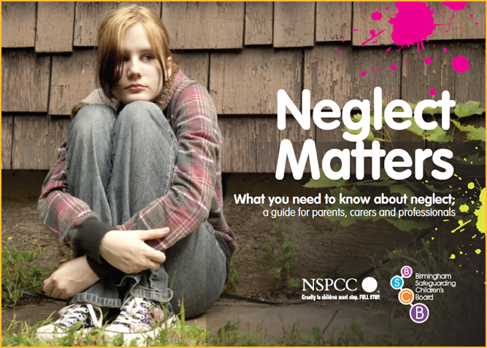
Overall increase and concerns
These figures echo concerns from our frontline teams that the pandemic has increased the risks of abuse and neglect, with children both more vulnerable and out of sight of people who can keep them safe.
The NSPCC is now warning that with most children back in schools and society, the hidden harms they experienced during the lockdowns will become visible.

Slide 7
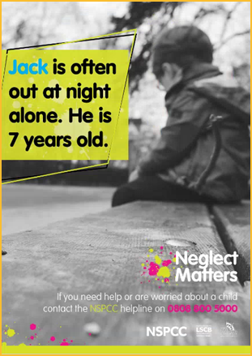
Case Study - Covid Neglect Helpline
Sisters, Chloe* and Debra*, found a young boy crying on the kerb outside their home and called the NSPCC Helpline for advice. They stayed on the phone for three hours to ensure he was taken to safety.
Debra* said: “He told her (Chloe*) that he was scared of his mum – that she hits him and he’d been suicidal over it. He kept bursting into tears and explained he’d run away because he’d broken his TV and was worried about what his mum would do.
“I was really aware that Covid lockdown was affecting young people’s mental health and being stuck at home in abusive circumstances were making things worse.
“I called the number and felt confident doing it. Seeing how upset he was, I knew I was doing the right thing. The practitioner was very calm and pleasant and asked lots of questions about the situation. We wanted to get the right help and support and the NSPCC wanted to make sure he was safe.”

Slide 8
Case Study - Childline Neglect
"ALWAYS LOCKED IN OUR BEDROOM“
"My home life got increasingly worse from the age of about 8 years old when mum's drug dealer partner moved in. Drugs took over family life. My brother and I were always locked in our bedroom as soon as we got home from school and then let out to go to school the next morning.
"Sometimes we didn't see mum for days at a time. We made our own breakfast and were given takeaway for dinner all the time, also in our bedrooms. I could hear the drug dealing going on.
"There was a constant stream of people dealing drugs at all hours in the flat and some of them were pretty scary, so mum and her boyfriend just wanted us out of the way. The flat was regularly raided by police, sometimes in the middle of the night. They would bang down the door, yelling and ordering us around. That was really rough.”

Slide 9
Social isolation and the risk of child abuse during and after the coronavirus pandemic - Key findings
We researched the risks children might be facing and the reasons why these might intensify during the pandemic. Our findings fall into three broad categories.
Increase in stressors to parents and caregivers
The research we reviewed confirms that the risk of child abuse is higher when caregivers become overloaded by the stressors in their lives. There are indications that the coronavirus pandemic has increased stressors on caregivers.
Increase in children and young people's vulnerability
There are indications that the conditions caused by the coronavirus pandemic have heightened the vulnerability of children and young people to certain types of abuse, for example online abuse, abuse within the home, criminal exploitation and child sexual exploitation.
Reduction in normal protective services
There is evidence that the ‘normal’ safeguards we rely on to protect children and young people have been reduced during the pandemic. However social connections and social support can provide a protective effect for children’s safety and wellbeing.

Slide 10
NSPCC Policy approach - our calls
To build a better future for children, no matter where they live, the NSPCC is urging Governments to focus on prevention and protecting children from neglect and abuse both online and offline, delivering a supportive environment in the early years, and ensuring services are available to help children recover from traumatic experiences.
For the UK Government this means:
1.Setting out how it will deliver the Best Start in Life Vision, including investment in rebuilding the health visitor workforce and new accountability mechanisms to ensure new parents and their babies receive consistent health visiting services with access to community-based targeted support.
2.Delivering early intervention support when it’s needed by addressing the funding gap in children’s social care, enhancing mental health and emotional wellbeing support in schools, and expanding support for families in the community. To help prevent and protect children from online harms, the UK Government needs to deliver the Online Safety Bill introducing a Duty of Care on tech firms, to be enforced by a statutory regulator.
3.Helping children recover from sexual abuse by bringing together funding streams for therapeutic and justice services to deliver support “under one roof” through local Child Houses, and ensuring children who have experienced domestic abuse can access specialist, community-based services wherever they live.

Slide 11
Margaret.Gallagher@nspcc.org.uk

Slide 12
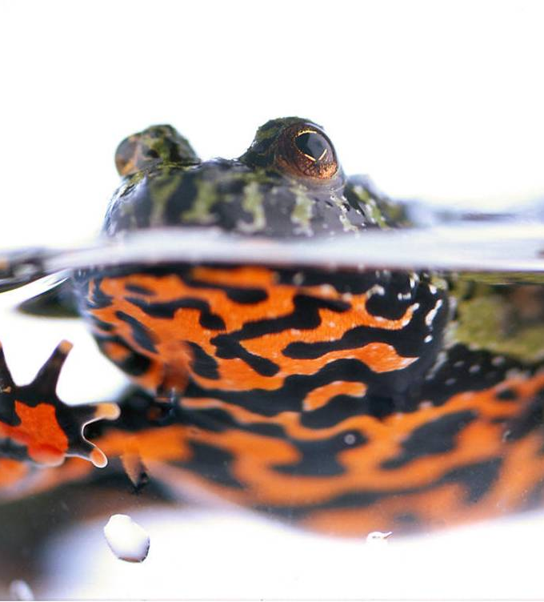
Neglect Matters
Like the frog in the saucepan the impact of neglect may be gradual, continuous and cumulative.
Professor Ray Jones
Notes:
Unlike other forms of harm, neglect does not scream for practitioners attention. It is primarily an act of omission (what carers fail to do). In the most concerning cases it is an unrelenting lack of care. Neglect is often an effect of other parental factors including parental substance misuse, parental mental ill-health, compromised parental capacity because of parents’ experience of poor parenting etc.

Slide 13

Learning from Local Reviews
Practice Is too variable
Neglect including extreme neglect can go unrecognised and unchallenged – ask “Is this good enough for my child?”
In the worse cases the practice is incident driven and not focused on the cumulative impact and ‘drip-drip’ effect of neglectful parenting
There is a need to learn from history and avoid the ‘start-again’ syndrome
Neglect and affluence

Slide 14
Three ‘Types’ of Neglect
Type 1 neglect might be characterised as ‘passive neglect’.
Type 2 neglect might be labelled ‘chaotic neglect’.
Type 3 neglect might be called ‘active neglect’.
Professor Ray Jones (2016) The Conundrum of Neglect, Professional Social Work (April 2016)
Notes:
Type 1 neglect might be characterised as ‘passive neglect’. Passive neglect is where parents, often single parent mothers, are ground down and exhausted by previous and current circumstances.
Type 2 neglect might be labelled ‘chaotic neglect’. Chaotic neglect is where parents may have had poor parenting experiences themselves and have little understanding of the needs of their children or how to parent well.
Type 3 neglect might be called ‘active neglect’. It is deliberate and intentional. Unlike Types 1 and 2 above it is not a consequence of parents who are exhausted or lacking competence. It is about anger and control. It is where a parent or parents turn on and scapegoat a child or children. It might involve
only one amongst several children becoming the focus and target of parental anger.
Both Type 1 and 2 neglect are slow-burning examples of the frog in the saucepan. They raise the very difficult issue of if and when to conclude that it is not getting better, despite the interventions, and is no longer to be tolerated for the child.

Slide 15
Neglect as Cumulative Harm
Both Type 1 and 2 neglect are slow-burning examples of the frog in the saucepan. They raise the very difficult issue of if and when to conclude that it is not getting better, despite the interventions, and is no longer to be tolerated for the child.
Professor Ray Jones (2016) The Conundrum of Neglect, Professional Social Work (April 2016)

Slide 16
Ecological transactional analysis (interacting risk factors) (Brandon et al 2010)
Adverse childhood experiences
Carers own relationship and history
Carer’s state of mind, level of reflective function (the carer’s ability to hold the child in mind)
Social stress,
Relationships,
Environmental Stressors
Care-giving environment generated by the carer
Child’s behaviour, adaptive strategies and developmental state

Slide 17
Defining Neglect – Working Together 2018
The persistent failure to meet a child’s basic physical and/or psychological needs, likely to result in the serious impairment of the child’s health or development. Neglect may involve a parent or carer failing to:
a. provide adequate food, clothing and shelter (including exclusion from home or abandonment)
b. protect a child from physical and emotional harm or danger
c. ensure adequate supervision (including the use of inadequate care- givers)
d. ensure access to appropriate medical care or treatment
It may also include neglect of, or unresponsiveness to, a child’s basic emotional needs.
Notes:
Persistent failure. How persistent is persistent? Sometimes how long is too long depends on how old the child is. The second more active synaptic activity of the brain occurs during adolescence. Persistent, therefore needs to be considered not only in relation to the length of time children and young people are exposed to such experiences, but also taking into account the extent in which these experiences are:
Intrusive: the depth by which they impact on the child/ young person’s health and wellbeing);
Pervasive: the breath/ number of aspects of child development, situations, people, etc. which are being affected
As well as in relation to:
The cumulative impact of individual experiences. Hindley and colleagues’ systematic review of risk factors for the recurrence of maltreatment highlights the cumulative nature of neglect since it is the most likely form of maltreatment for a child to re-experience (Hindley et al, 2006).
The frequency, type and intensity of parental neglectful actions (acts of omission)
The meaning of the child/ young person for the parent/ carer/family; holding the child responsible for the problem (acts of commission)
The absence of change
Likely to. Predicting likelihood requires a good knowledge of child development, observation skills, an understanding of parenting and parenting capacity and the application in practice of relevant research.
Serious impairment. This needs to be measured not only in relation to the impact of individual neglectful experiences but also the cumulative impact of those experiences on children and young people. Cumulative harm may be caused by an accumulation of a single adverse circumstance or event, or by multiple different circumstances and events. The unremitting daily impact of these experiences on the child can be profound and exponential, and diminish a child’s sense of safety, stability and wellbeing. (Bromfield and Miller 2007) Hindley, N., Ramchandani P.G., Jones, D.P.H., (2006), Archives of Disease in Childhood, Risk Factors for Recurrence of Maltreatment: A Systematic Review, Volume 91, Issue 9, 744-752, 2006

Slide 18
Forms of Neglect Professor Jan Horwath (2007)
Medical neglect.
Nutritional neglect.
Emotional neglect
Educational neglect.
Physical neglect.
Lack of supervision and guidance.
Notes:
Medical neglect – this involves carers minimising or denying children’s illness or health needs, and failing to seek appropriate medical attention or administer medication and treatments.
Nutritional neglect – this typically involves a child being provided with inadequate calories for normal growth. This form of neglect is sometimes associated with ‘failure to thrive’, in which a child fails to develop physically as well as psychologically. However, failure to thrive can occur for other reasons, independent of neglect. More recently, childhood obesity resulting from an unhealthy diet and lack of exercise has been considered as a form of neglect, given its serious long-term consequences.
Emotional neglect – this involves a carer being unresponsive to a child’s basic emotional needs, including failing to interact or provide affection, and failing to develop a child’s self-esteem and sense of identity. Some authors distinguish it from emotional abuse by the intention of the parent.
Educational neglect – this involves a carer failing to provide a stimulating environment, show an interest in the child’s education at school, support their learning, or respond to any special needs, as well as failing to complying with state requirements regarding school attendance.
Physical neglect – this involves not providing appropriate clothing, food, cleanliness and living conditions. It can be difficult to assess due to the need to distinguish neglect from deprivation, and because of individual judgements about what constitutes standards of appropriate physical care.
Lack of supervision and guidance – this involves a failure to provide an adequate level of guidance and supervision to ensure a child is physically safe and protected from harm.

Slide 19
Neglect and Affluence
Identifying neglectful parenting in the context of material affluence is a multi-faceted process. Social workers have to navigate complex power relationships with highly-resistant parents who have the economic, social and cultural capital to resist their interventions.
Bernard, Claudia A (2019) Recognizing and Addressing Child Neglect in Affluent Families. Child and Family Social Work, 24(2), pp. 340-347. ISSN 1356-7500

Slide 20
Perennial Issues from SCRs/LCSPRS
Professional curiosity – what do you see, hear, know and what does it mean especially for children
Authoritative Practice – focus on children, clear about bottom line safety
Neglect and Cumulative Harm
Thresholds discussions/decisions
Domestic abuse – especially coercive control
Effective, relevant and timely information sharing
Effective multi-agency working – each part seeing the whole
Engaging with fathers/males in the family
Escalation and professional agreement
Notes:
Errors in thinking such as ‘rule of optimism’, ‘start again syndrome’, fixed views – e.g. ‘this is a good family’ or ‘these are nice people’
Social class, status and safeguarding

Slide 21


Slide 22

GCP2 Project Manager Alex Dave
Graded-Care-Profile2-FAQs.pdf (surreyscp.org.uk)
Neglect Risk Assessment Tools – General Guidance
Graded Care Profile 2: measuring care, helping families - YouTube

Slide 23

GCP2 Project Manager Alex Dave

Slide 24

Family Information and Local Offer
Children who make good overall progress in most areas of development and receive appropriate universal services such as health care and education.
They also use leisure and play facilities, housing and the voluntary sector.
Family Information Service (information on resources) www.surreycc.gov.uk/people-and-community/family-information-service/

Slide 25
The SCSA partnership learning and development offer aims to enhance working together to safeguard children and improve outcomes for children and families in Surrey. Our workshops and learning events give the opportunity for practitioners to:
Share knowledge and explore understanding of their differing roles
Understand how safeguarding operates in Surrey by sharing good practice, resources and processes; this includes Effective Family Resilience and Family Safeguarding model
Learn from each other’s experience and practice in terms of safeguarding and delivering positive outcomes for children
Develop best practice and learning from local reviews and audits, domestic homicide reviews, the Child Death Overview Panel (CDOP) and national learning

Slide 26
Core Offer
Learn together to ensure clear pathways for support, effective multi-agency working and early help provision as well as clear understanding and consistent application of thresholds across the partnership
Working together to safeguard children (online offer, face to face and Train the Trainer)
Effective Family Resilience
Helping Families Early
Foundation Modules 1 and 2
DSL new to role and refresher (Education Safeguarding Team)
Managing Allegations against staff and volunteers (Education Safeguarding Team) – includes sessions for non-education practitioners
Healthy outcomes for children who are looked after

Slide 27
Olive booking link; https://surreycoun.plateau.com/learning/user/portal.do?siteID=SCA&landingPage=login
Neglect training offers to ensure that practitioners are supported with the awareness, skills and tools to effectively intervene where neglect is a factor;
Introduction to Neglect
GCP2 programme (includes Train the Trainer)
Train the Trainer (Learning from Practice)
Included in all learning activities of the core offer
Introduction to Neglect Workshops
19 July 2021
06 October 2021
02 February 2022
27 April 2022

